Slide 1
A “flow record” is simply a summary of information about a flow, which typically includes the source and destination IP address, ports, date and time, and the amount of data transmitted.
A “sensor” is what we commonly call the device that is used to monitor the flows of traffic on any given segment and extract critical bits of information in a flow record. Network equipment rarely includes much disk space for storing logs of any type, including network flow data
Flow Record Processing System Flow record processing systems include the following components:
• Sensor—The device that is used to monitor the flows of traffic on any given segment and extract important bits of information to a flow record.
• Collector—A server (or multiple servers) configured to listen on the network for flow record data and store it to a hard drive.
• Aggregator—When multiple collectors are used, the data is typically aggregated on a central server for analysis.
• Analysis—Once the flow record data has been exported and stored, it can be analyzed using a wide variety of commercial, open-source, and homegrown tools

Slide 2
Flow analysis Techniques
(a) Filtering is a general term for narrowing down a large pool of evidence to a subset—or groups of subsets—that are of interest. This is a fundamental technique in nearly every investigation that involves flow record data, since normally investigators are provided with far more flow record data than is relevant for the case at hand and must select only small percentages for detailed analysis and presentation.
(b) Baselining Using flow record data, network administrators can build a profile of “normal” network activity. Forensic investigators can compare flow record traffic to the baseline profile in order to identify anomalies.
(c) ‘‘Dirty Values’’ A common strategy in digital forensics of all types is to compile a list of suspicious keywords or other values to use when searching for evidence relevant to a case. For flow record data specifically, “dirty values” might include IP addresses, ports, or protocols.
(d) Activity Pattern Matching
Every activity leaves a fingerprint on the network. Simple patterns, such as large unidirectional volumes of traffic flow, can indicate specific activities that may be suspicious given the context (such as the presence of a high-volume, Internet-accessible file server on a subnet that should only contain company workstations). More complex patterns may match the behaviors of known worms or viruses. A trained investigator can pick out suspicious activity that manifests as complex and subtle variations in flow record evidence

Slide 3
What is a Router?
A router is a network device that serves two primary functions:
it connects multiple computers, phones, tablets, or other devices to form a managed local area network, and
(2) it provides Internet access to all of the compatible devices that are connected to the router.
A local area network (LAN) can be set up by simply deploying a router and connecting one or several devices
What is an Access Point?
An access point is a wireless network device that acts as a portal for devices to connect to a local area network.
Access points are used for extending the wireless coverage of an existing network and for increasing the number of users that can connect to it. A high-speed Ethernet cable runs from a router to an access point, which transforms the wired signal into a wireless one. Wireless connectivity is typically the only available option for access points, establishing links with end-devices using Wi-Fi.
Main Differences. The router acts as a hub that sets up a local area network and manages all of the devices and communication in it.
An access point, on the other hand, is a sub-device within the local area network that provides another location for devices to connect from and enables more devices to be on the network. Wireless routers can function as access points, but not all access points can work as routers.
While routers manage local area networks, communicate with outside network systems, acquire, distribute, and dispatch data in multiple directions, establish a point of connectivity, and ensure security, access points typically only provide access to the router’s established network.

Slide 4

What is a wireless access point?
A wireless access point (WAP) is a networking device that allows wireless-capable devices to connect to a wired network. It is simpler and easier to install WAPs to connect all the computers or devices in your network than to use wires and cables.
Why use a WAP to set up a wireless network?
Using a WAP lets you create a wireless network within your existing wired network, so you can accommodate wireless devices.
Wireless access points contain both volatile and nonvolatile evidence, although due to their persistent storage capabilities tend to be very limited.
Enterprise
Consumer

Slide 5
Types of evidence
Volatile :
History of connections by MAC address
List of IPs associated with MACs
Historical logs of wireless events (access requests, key rotation, etc.)
History of client signal strength (can help identify geographic location)
Routing tables
Stored packets before they are forwarded
Packet counts and statistics
ARP table (MAC address to IP address mappings)
DHCP lease assignments
Access control lists
I/O memory
Running configuration
Processor memory
Flow data and related statistics
The WAP operating system and startup configuration files are maintained in persistent storage by necessity.
Persistent evidence you may find on a WAP includes:
• Operating system image • Boot loader • Startup configuration files

Slide 6
Common Attacks
Sniffing An attacker eavesdrops on the network
Rogue Wireless Access Points Unauthorized wireless devices that extend the local network, often for an end-user’s convenience
The Evil Twin Attack An attacker sets up a WAP with the same SSID as a legitimate WLAN
WEP Cracking An attacker attempts to recover the WEP encryption key to gain unauthorized access to a WEP-encrypted network

Slide 7
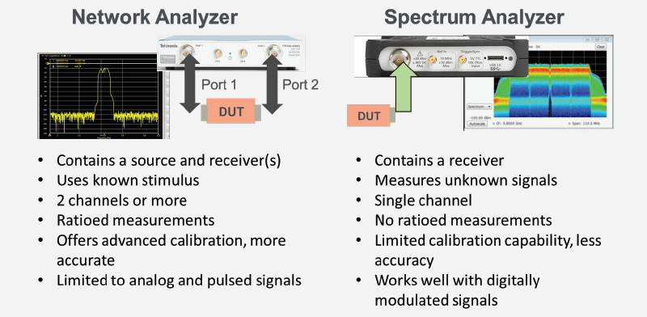
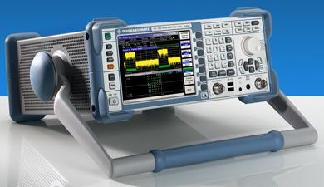
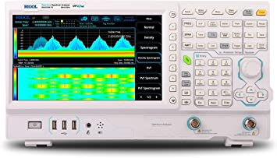
Wireless traffic capture and analysis
Capturing and analyzing wireless traffic often provides valuable evidence in an investigation
Spectrum Analysis : A spectrum analyzer is a device that measures and displays signal amplitude (strength) as it varies by frequency within its frequency range (spectrum)

